Slide 1
Vidyasagar R
Flight Predictions and Cancellations using Random Forest
3/21/2024 Annual Review

Slide 2
PROJECT TITLE :
Flight Predictions and Cancellations using Random Forest
3/21/2024 Annual Review

Slide 3


AGENDA :
1. Introduction to Random Forest
2. Understanding the Dataset
3. Data Preparation
4. Training the Random Forest Model
5. Model Evaluation
6. Prediction
3/21/2024 Annual Review

Slide 4

PROBLEM STATEMENT :
Objective: Develop a machine learning model using the Random Forest algorithm to predict flight cancellations and delays.
Data: The model will be trained on historical flight data, which may include features such as:
Flight Details: Origin, destination, airline, flight number, scheduled departure/arrival time
Weather Conditions: Temperature, wind speed, visibility at origin and destination airports
Aircraft Information: Aircraft type, age
Historical Data: Past delays and cancellations for the specific route and airline
3/21/2024 Annual Review

Slide 5

PROJECT OVERVIEW
Why is this important?
->Passengers can be informed of potential disruptions, allowing them to adjust
travel plans accordingly.
->Airlines can improve operational efficiency by allocating resources and planning
for potential delays or cancellations.
Challenges to Consider:
Data Quality: Inaccurate or incomplete data can significantly impact model performance.
External Factors: Events beyond the data (e.g., mechanical issues) might limit prediction accuracy.
Model Explainability: Understanding how the model arrives at its predictions can be challenging with Random Forest.
3/21/2024 Annual Review

Slide 6

WHO ARE THE END USERS?
Air Passengers:
->Informed decision-making: Passengers can be alerted to potential delays or cancellations in advance, allowing them to adjust travel plans (rebooking flights, arranging transportation at the destination).
Airlines:
->Improved operational efficiency: By anticipating disruptions, airlines can allocate resources (crews, aircraft) more effectively and proactively plan for delays or cancellations (rebooking passengers, arranging for ground transportation).
->Improved customer satisfaction: By minimizing delays and cancellations, airlines can enhance customer satisfaction and potentially increase loyalty.
Travel Booking Platforms & Aggregators:
->Integrate flight prediction information into their platforms to provide a more comprehensive service to their users.
->This can improve customer experience and potentially increase bookings.
3/21/2024 Annual Review

Slide 7

YOUR SOLUTION AND ITS VALUE PROPOSITION
Solutions for Disruptions:
Cancellation Prediction:
->Proactively notify passengers and rebook them on alternative flights.
->Prepare ground staff and resources to handle cancellations efficiently.
Delay Prediction:
->Inform passengers about potential delays, allowing them to adjust their travel plans.
->Prepare for delays by having ground staff and resources readily available.
Values:
->Data-Driven Decision Making
->Scalability
->Improved Public Perception
3/21/2024 Annual Review

Slide 8

THE WOW IN YOUR SOLUTION
Let's delve into a "wow" solution for predicting flight cancellations using Random Forest:
Feature Engineering Magic
Ensemble of Models
Ensemble of Models
Interactive Visualization
Real-time Updates
3/21/2024 Annual Review

Slide 9
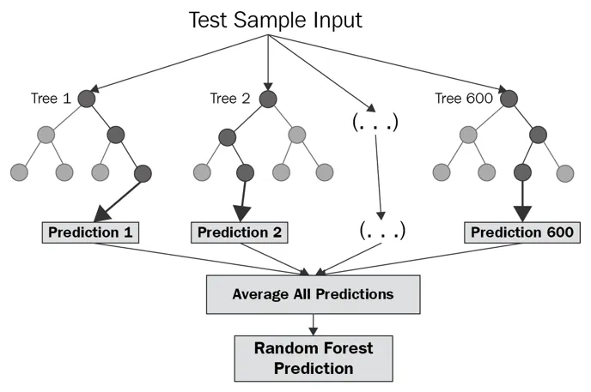
MODELLING :
3/21/2024 Annual Review

Slide 10
RESULTS :
The random forest model was capable of predicting flight delays with an accuracy of 92.7%, indicating the compatibility of this learning model with the flight delay prediction problem. Consequently, the random forest has been used in many studies in this field.

